Slide 1
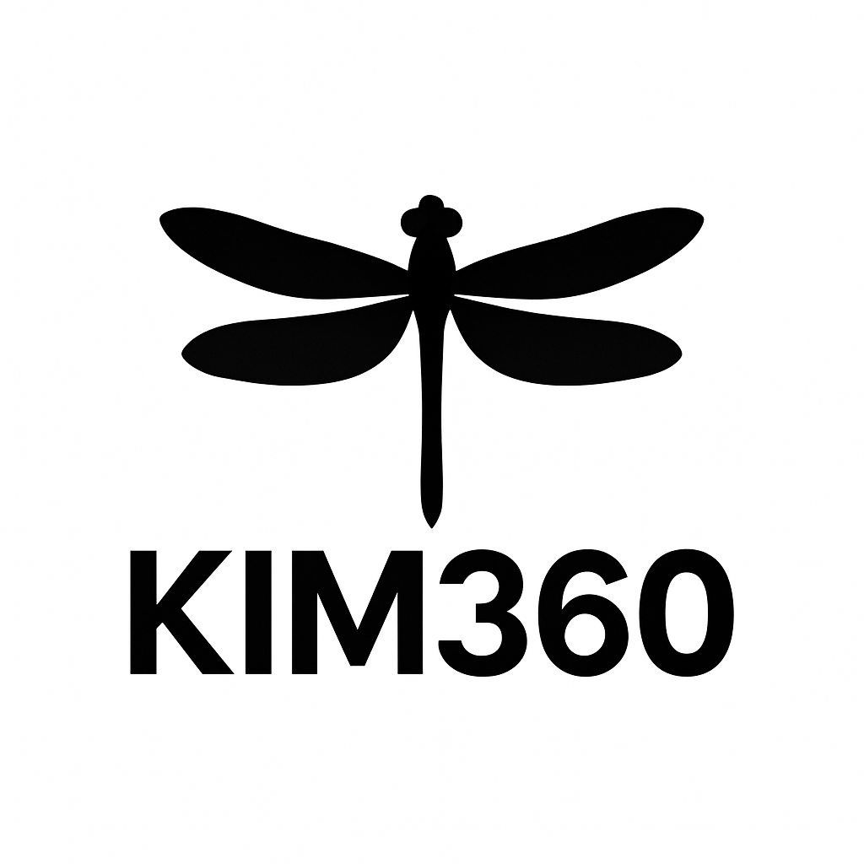
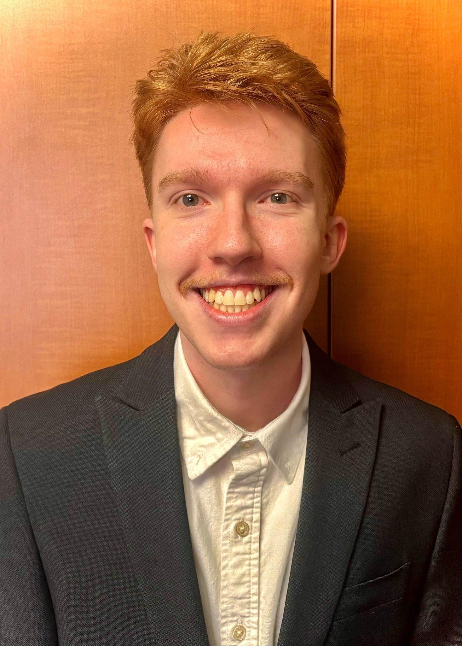
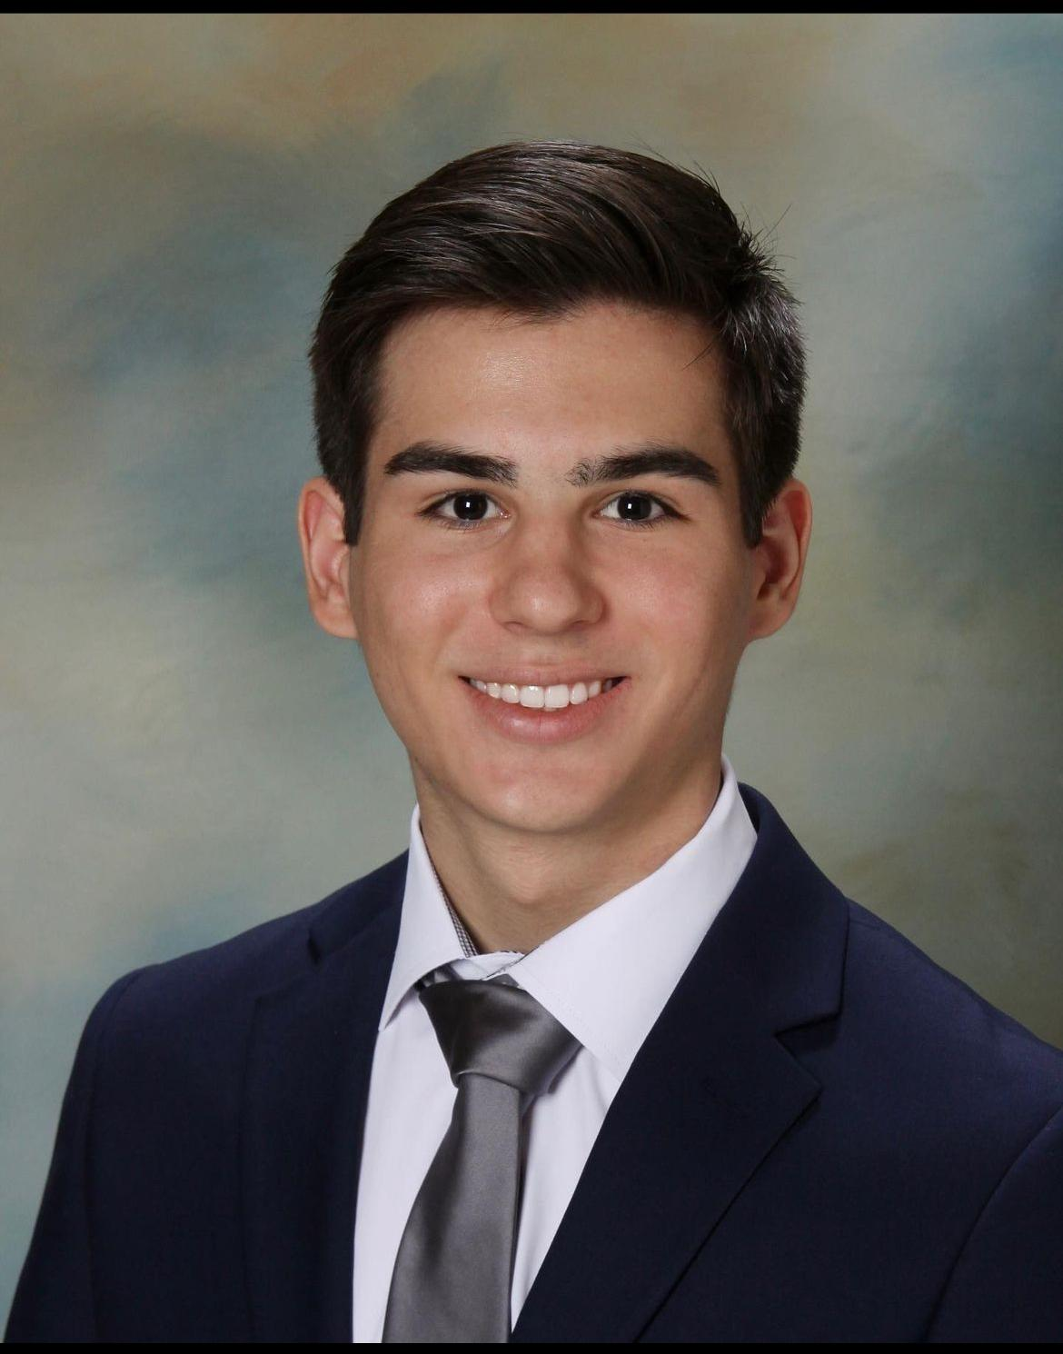
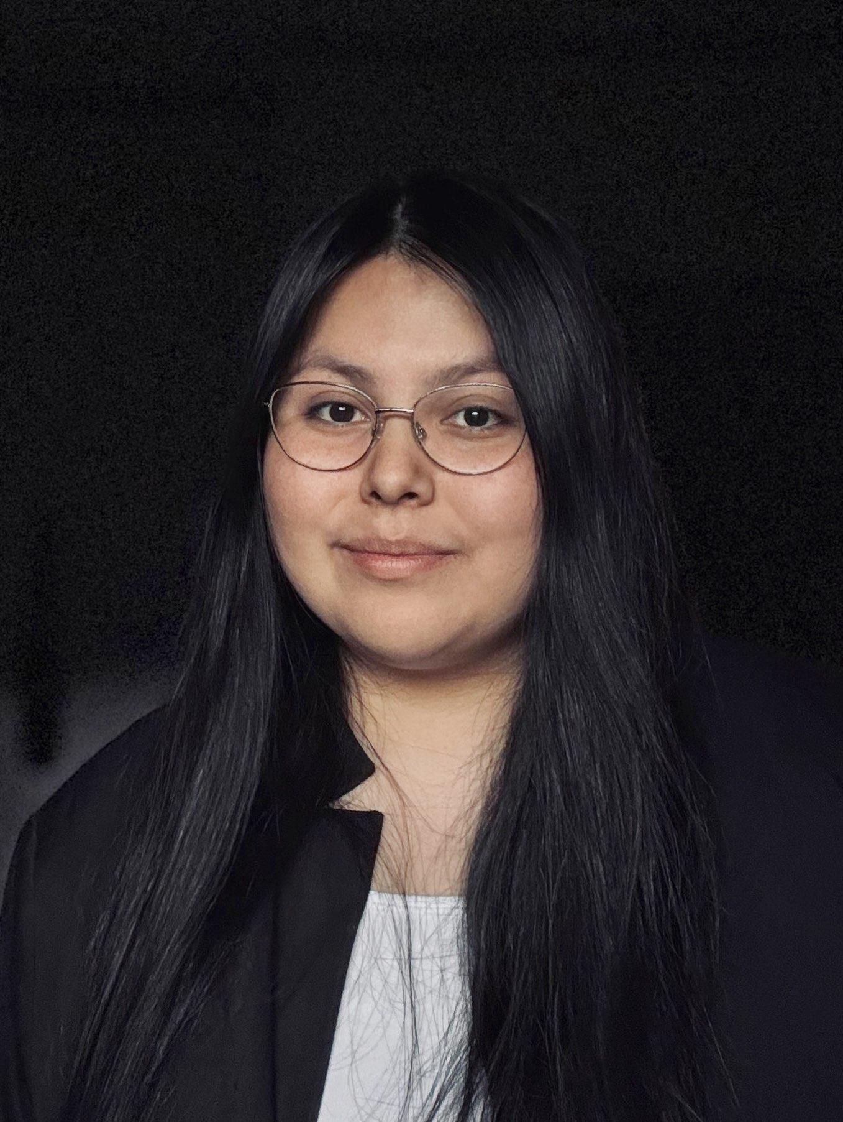
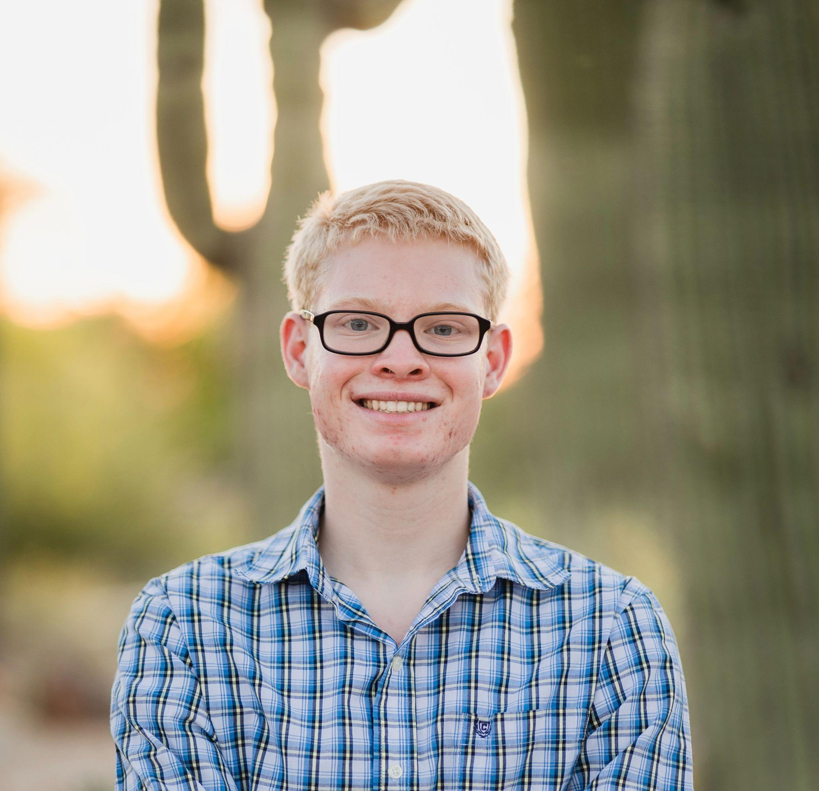
KIMinder360 Mobile App:
Design Review
Client: Morgan Boatman
Team Mentor: Md Nazmul Hossain
Dylan Hyer
Team Leader
deh277@nau.edu
Nyle Huntley
Release Manager
nah353@nau.edu
Cole Bishop
Recorder
cdb499@nau.edu
Mayanna John
Architect
mrj335@nau.edu
Notes:
Hello, we are the KIMinder360 team. I’m Cole Bishop. I’m Dylan Hyer. I’m Nyle Huntley. I’m Mayanna John.
Our Client is Morgan Boatman, the founder of Winter Communication LLC and our Team Mentor is Nazmul Hossain
Our project focuses on transforming manual situational awareness training into an automated and scalable mobile app.
With this approach we aim to improve environmental awareness and emergency preparedness through automated directives delivered via a smartphone app.

Slide 2

Problem Statement
Situational awareness is at an all time low
Being more aware can help you in emergencies
Our client has created awareness training in the past
Poor scalability due to manual implementation
Notes:
Modern society shows a growing need for situational awareness, people are constantly distracted by their phones while in public and often pay no attention to their surroundings.
Practicing situational awareness and being more conscious of your surroundings can help you be more prepared for emergencies and better at noticing details that you would otherwise miss. Most wellness and mindfulness apps are focused on self reflection and fitness, not building active awareness skills, meaning that no tool exists for continuous situational awareness training.
Our client, Morgan Boatman has attempted to solve this in the past with gamified experiences like KIMinder360 which revolves around short tasks called directives that encourage people to pay attention to their surroundings.
The previous implementation of KIMinder360 relied on the manual distribution of directives to users through direct contact from Morgan.
The major pain point of this approach is the lack of automation. There was no way to automatically choose a directive, schedule it to go out at a specific time, and send it. All of this had to be done by hand making it difficult to scale for more users as the workload would increase with user count.

Slide 3
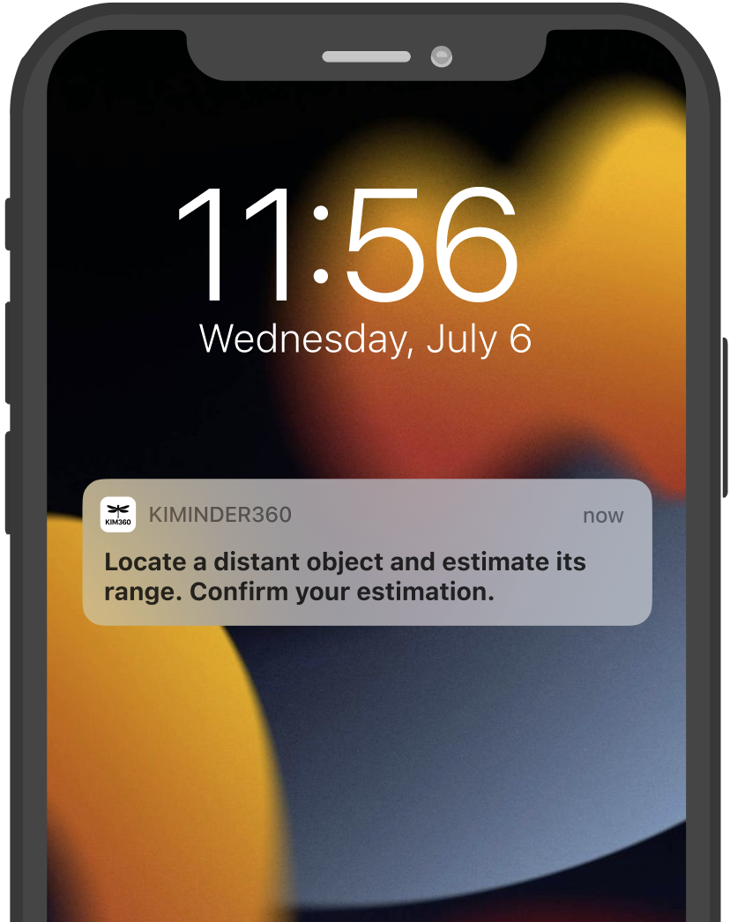
Proposed Solution: KIMinder360 App
Automated directive reminders
Flexible directive categories and reminder frequencies
Hours of manual effort eliminated
Offline availability for training anywhere
Notes:
Our solution, KIMinder360, is a mobile application designed to completely automate the directive delivery process for our client. Rather than relying on manual phone calls like Cole mentioned, KIMinder360 will send real-world situational awareness directives straight to users’ phones through push notifications. Users will simply be able to download the app, choose which training categories they’re interested in, and set their preferred action windows, the times of day they’d like to receive reminders. From there, the app will automatically handle the rest, sending randomized directives that will usually take just a few moments to complete but encourage consistent mindfulness habits over time. And since all directive data will be stored locally, the app will work fully offline, allowing users to train anytime, anywhere.

Slide 4
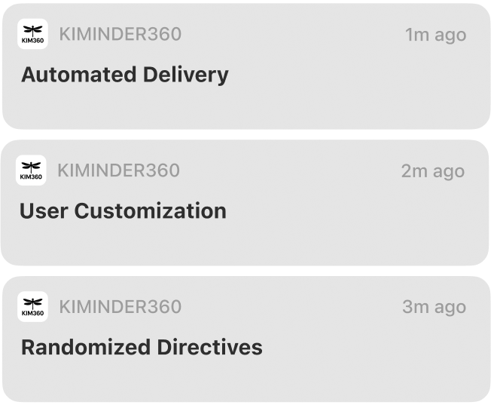
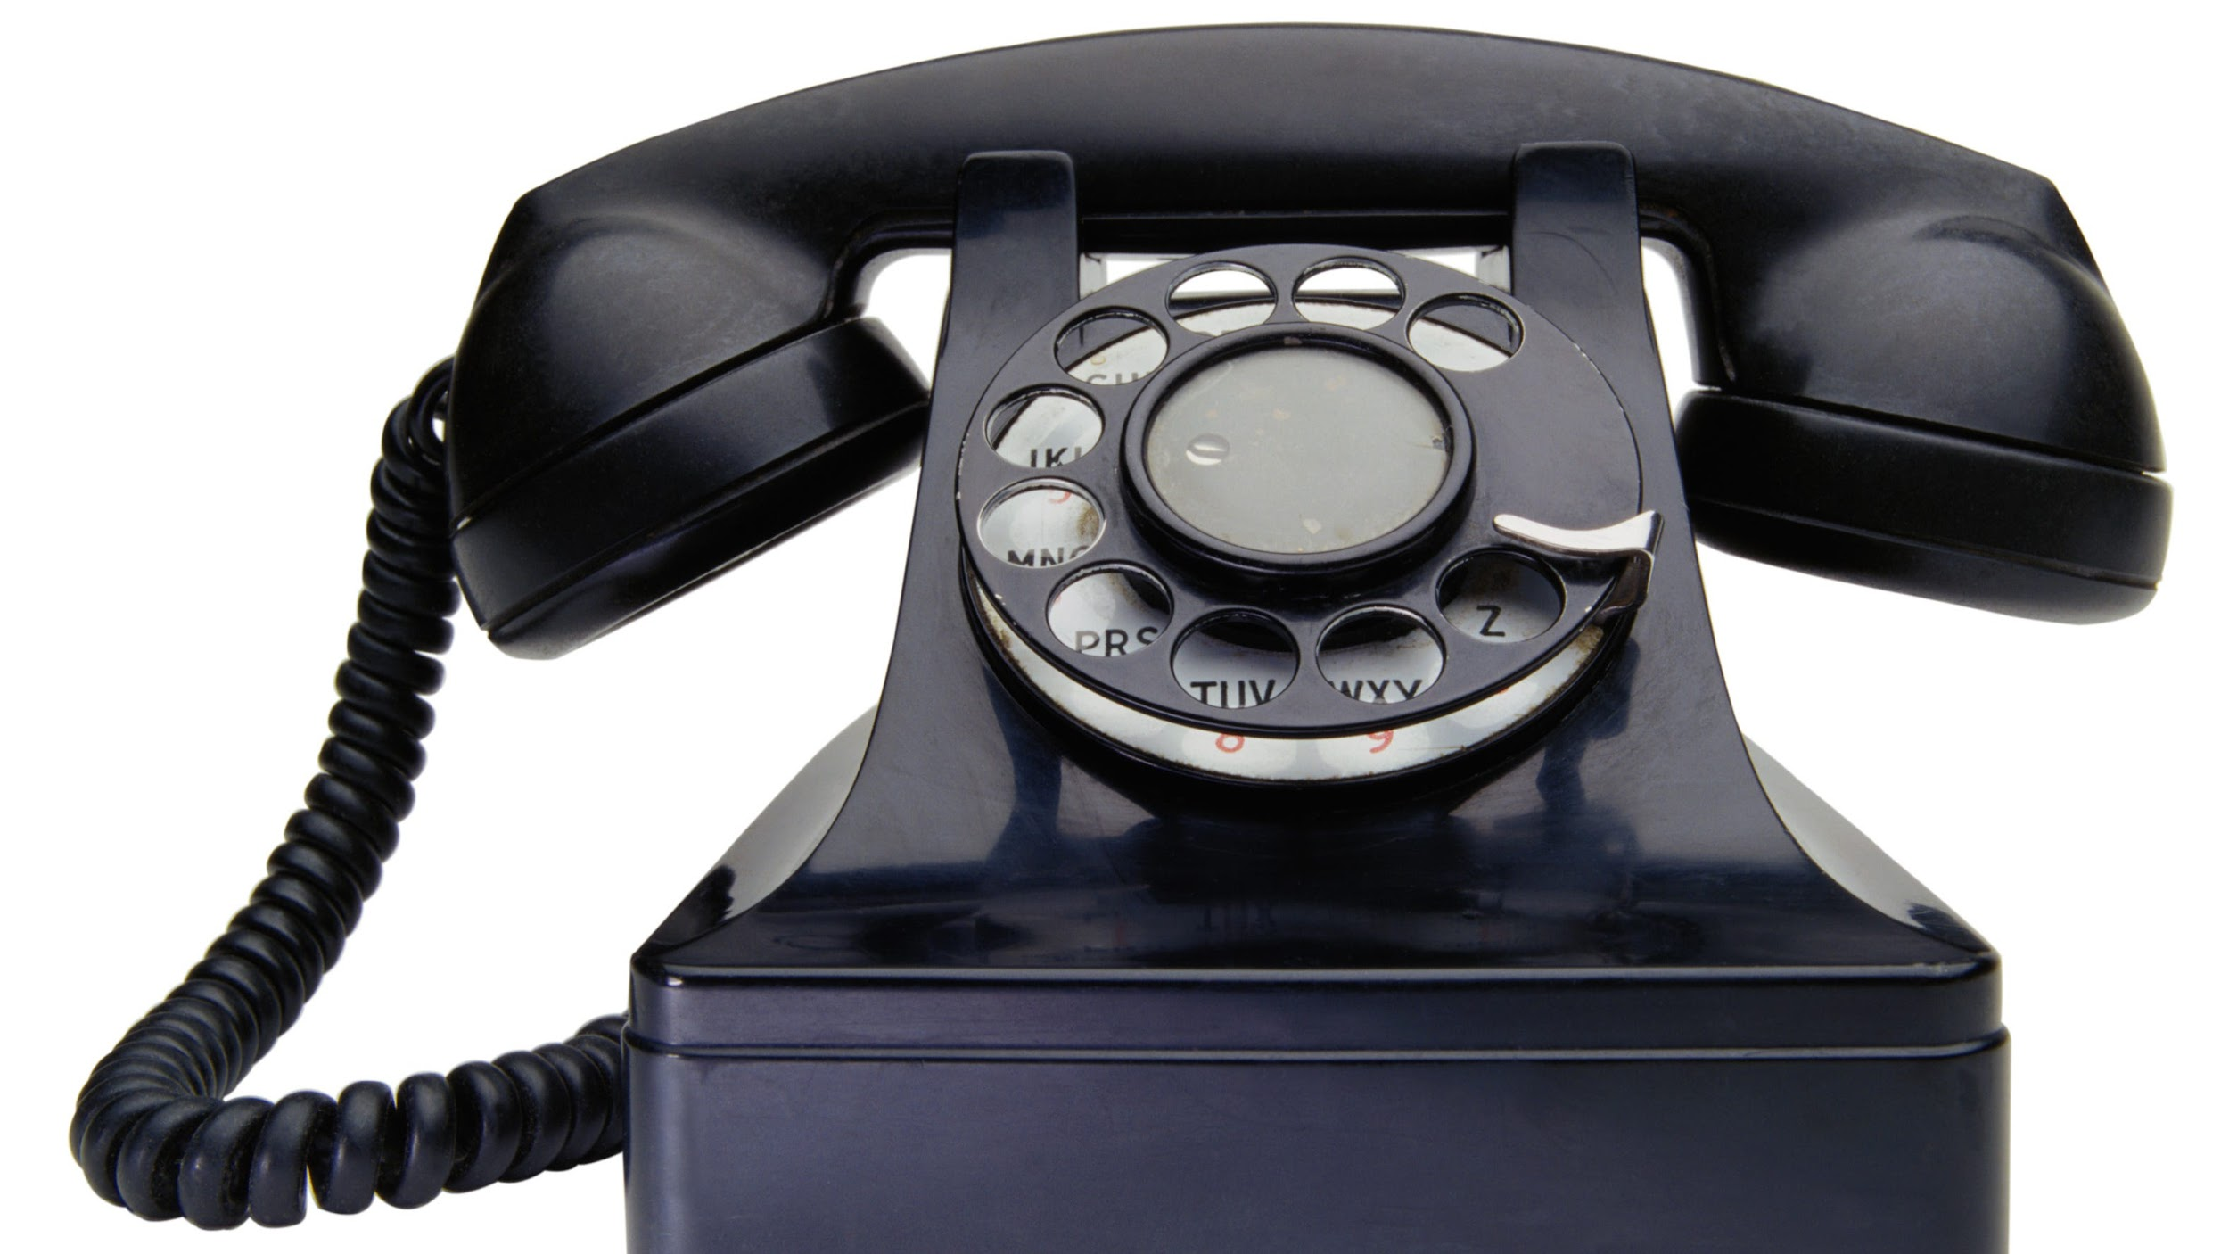
How KIMinder360 Solves Our Client’s Challenges
Before
After
One manual phone call per user, same time every day, no customization
Fully automated, personalized, dynamic experience
Notes:
Each of KIMinder360’s core features directly improves on the original manual process. Firstly, those daily phone calls are replaced with automated push notifications, completely eliminating the time consuming manual process. Next, the category and action window settings give users full customizability over the training experience, something that previously wasn’t feasible. And lastly, the randomized directive system keeps the training experience fresh and engaging, ensuring no directives are repeated within too short a time span. Altogether, these features make an app that fits perfectly into modern routines, helps train these critical, life saving skills, and is accessible to anybody with a smartphone.

Slide 5
Key Requirements
Domain-Level Requirements
Automated situational awareness training
User customization and scheduling
Directive management and data handling
Scalability and future growth
Performance Requirements
System responsiveness
Data management and storage
Usability and user learning
Performance efficiency
Functional Requirements
Push notifications
Category selection
Database of directives
Active hours selection
Environmental Requirements
Hardware and platform constraints
Software and development constraints
External standards
Operational environment
Notes:
Key Requirements (~2.5-3.5 minutes)
Explain how you gathered the project’s requirements (e.g., client meetings, site visits, document analysis).
Highlight the most important user and functional requirements (i.e., the MVP).
Choose one high-level requirement to demonstrate how it breaks down into detailed sub-requirements.
Conclude by mentioning that requirements will evolve, but emphasize the strength of your initial baseline.

Slide 6
Risks and Feasibility
Dangerous Community Submitted Directives
Excessive/Poorly-Timed Notifications
Mitigation Strategy:
Start with a closed, pre-approved directive set.
Mitigation Strategy:
Allow users to set Active Hours and notification frequency to prevent interruptions.
Continuous Review for Safety & Usability
Lack of Directive Randomization
Ambiguous or Misinterpreted Directives
Mitigation Strategy:
Tag directives by category and track recently used prompts.
Mitigation Strategy:
Review directive wording with the client before adding them to the database.
Notes:
Risks and Feasibility (~1.5 minutes)
Summarize the main project risks and your mitigation strategies.
Briefly discuss any feasibility analyses you conducted, outlining critical findings.
Focus on risks relevant to the project and client, avoiding personal or team-centric risks.

Slide 7
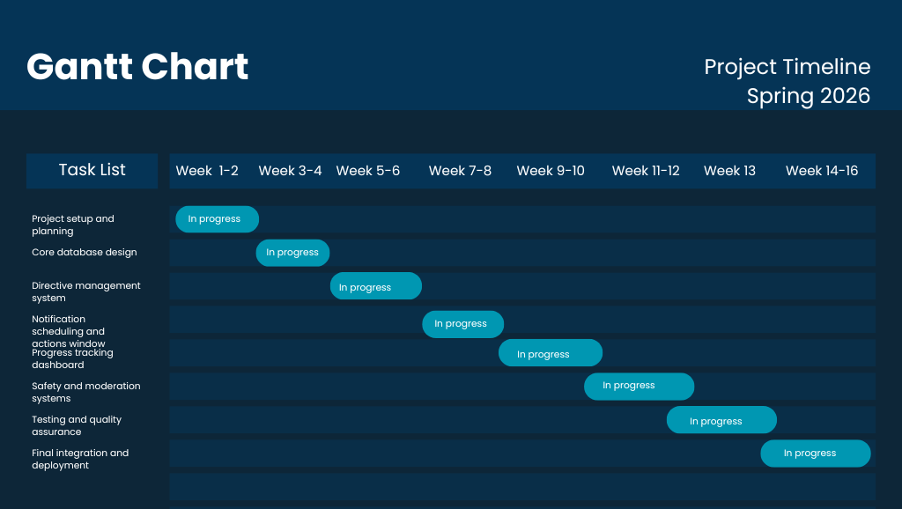
Schedule
Notes:
Schedule (~30 seconds)
Present a brief overview of your project timeline using a visual like a Gantt chart.
Indicate completed milestones and upcoming tasks, noting your current project status.
Make a succinct statement about your progress, whether you are on track or have areas needing attention.

Slide 8
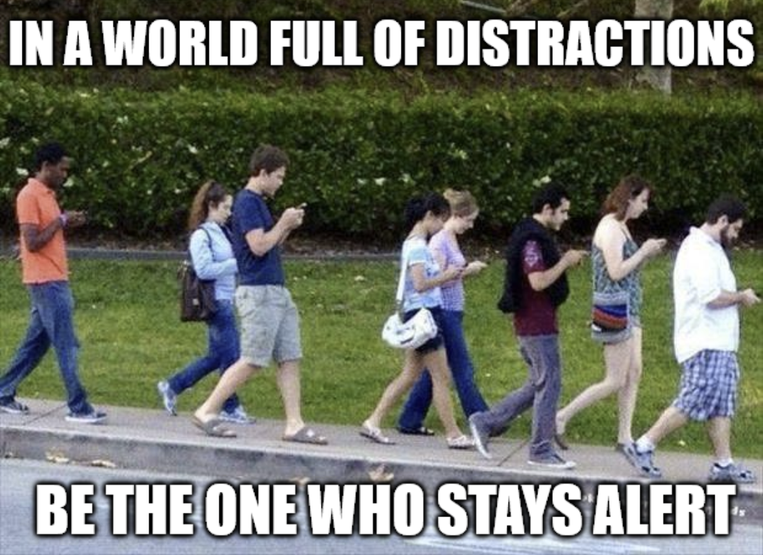
Conclusion
Fix scalability problem with a mobile app
Reduce workload on our client
Make awareness training more accessible
Solution revolves around 4 key features
Notes:
In conclusion we aim to solve the problem of scalability faced by the previous iteration of KIMinder360 by creating an app that automates awareness training.
By doing this we can significantly reduce the workload on our client that would come with a larger KIMinder360 user base
And make situational awareness training more accessible for all to result in a world where being aware is commonplace.
The major requirements of this app are push notifications, category selection, a database of directives and active hours customization.
We are confident in our ability to deliver on our promises thanks to extensive preparation we have done in planning every aspect of the eventual implementation.
Going forward we will begin developing our must have functional requirements in close cooperation with our client Morgan to ensure each aspect of the application is built according to his vision.

Slide 9
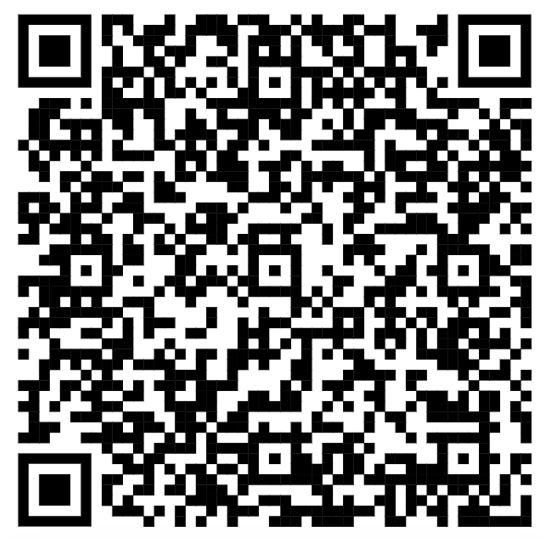
Thank You!
KIMinder360 Team
Please Contact us with any Questions!
Our Website!
Dylan Hyer
deh277@nau.edu
Nyle Huntley
nah353@nau.edu
Cole Bishop
cdb499@nau.edu
Mayanna John
mrj335@nau.edu
Notes:
Thank you! If you have any questions please feel free to ask now

